Slide 1

City of Concord
State of the City
2025
Mayor Byron O. Champlin

Slide 2
BASIC INFORMATION ABOUT CONCORD
Population:
  44,629 (80,000 Daytime)
  2.3 Persons Per Household
Housing Supply
  2010: 18,852 Units
  2022: 19,426 Units
  + 574; 3% Increase Over 12 Years
Median Home Price
  2019: $228,500 (NNHFA)
  2024: $390,000 (NHHFA)
  70.7% Increase
Median Rent
  2019: $1,189 / Month
  2024: $1,525 / Month (NHHFA; All Units)
  28.25% Increase
Rental Vacancy Rate
  “All Units” = 0.6% (2024 NHHFA)
  “Balanced Market” = 5%
Housing Choice Vouchers
  373 Total in Concord (September 2021)
Shelter Beds: 90 +/-

Slide 3
SUMMARY OF TOTAL UNITS IN DEVELPOMENT
Status | Total Units | Percent of Total
1. Recently Completed or Nearing Completion | 362 | 15%
2. Under Construction | 222 | 9%
3. Development Approvals Secured / Construction Pending | 783 | 33%
4. Currently In Development Permitting | 985 | 42%
Total | 2,352
Affordable / Workforce Units | 425 | 18%
Rentals | 1,738 | 74%
Potential Population Change (2.3 Persons / Unit) | 5,410

Slide 4

STATE DESIGNATED CONCORD AS A
“HOUSING CHAMPION”

Slide 5
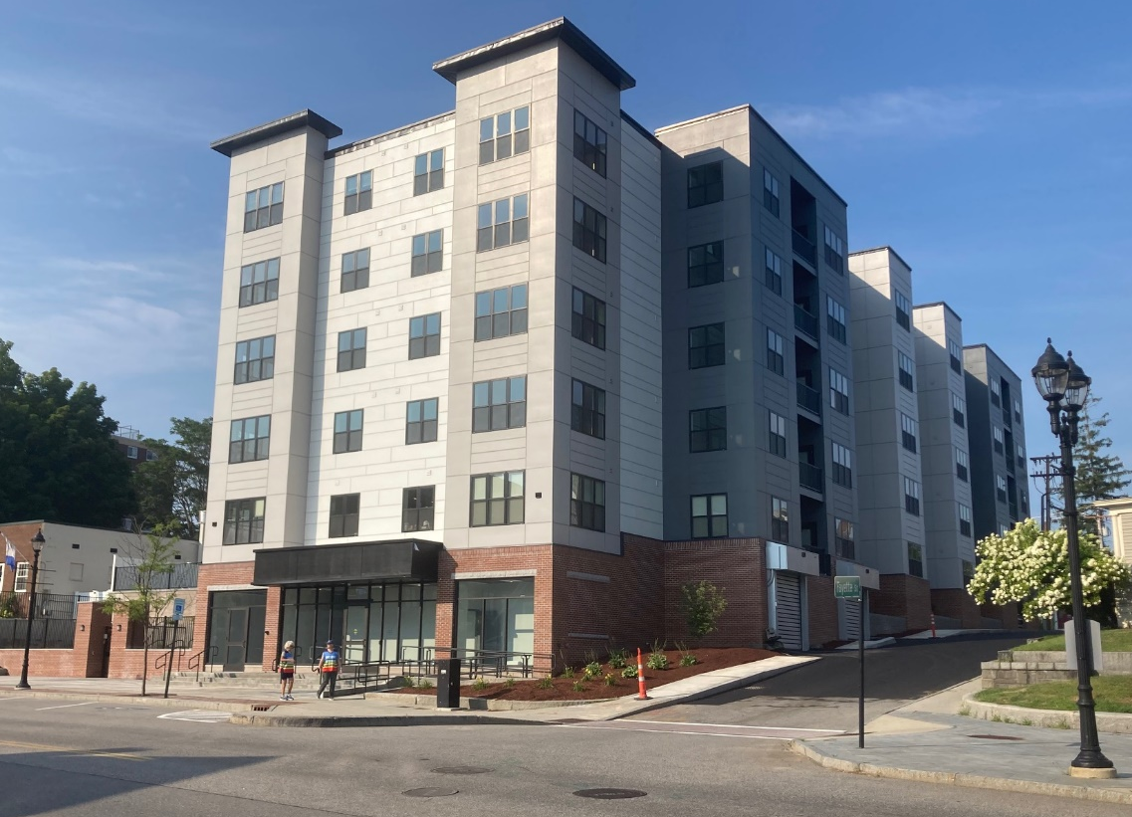
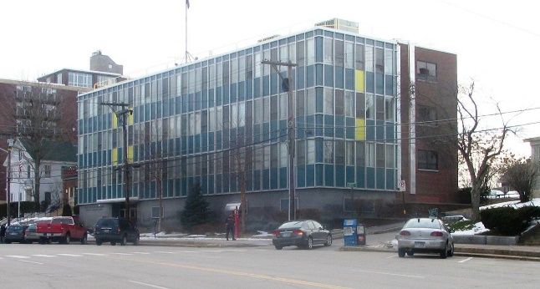
ISABELLA APARTMENTS (AUGUST 2024)
120 SOUTH MAIN STREET
John Flatley Company
64 Units
Rental
Market Rate
Phased Project
City Support:
  Sold Property to Developer (2022)
  Underground Utilities (2017 during Main Street Project)
  Interior Asbestos Abatement
  Zoning

Slide 6
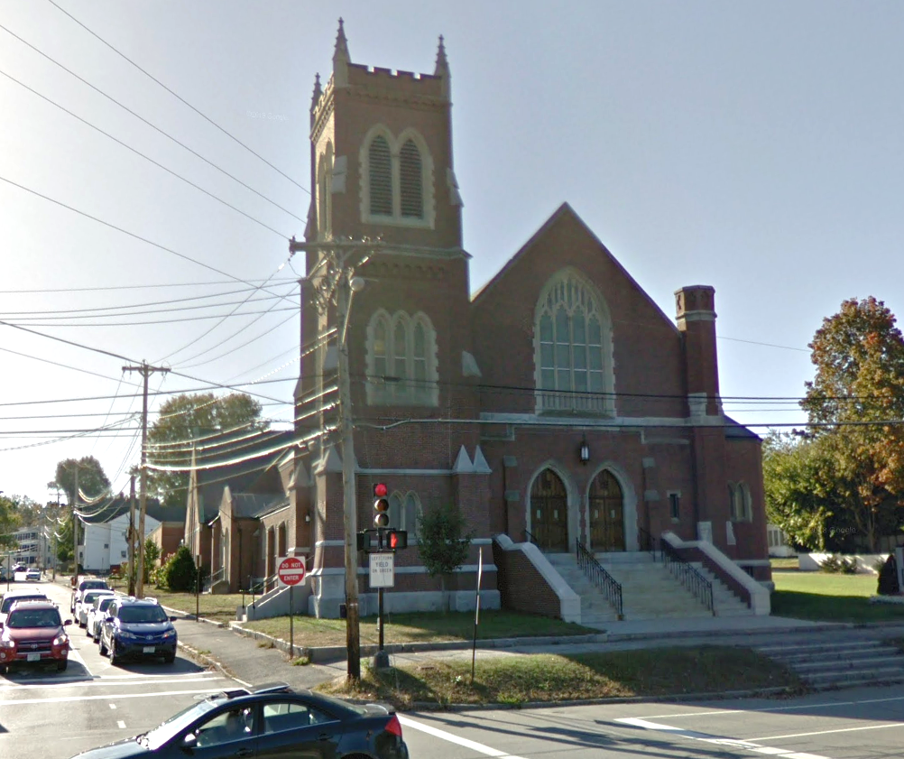
FIRST CHURCH
177 NORTH MAIN STREET
Jon Chorlian / Ben Kelley
30 Units
Rental
Market Rate
Projected Completion: Fall 2025+/-
City Support:
  RSA 79-E Community Revitalization Tax Relief Incentive (7 Years; $393,411 Property Tax Savings)

Slide 7
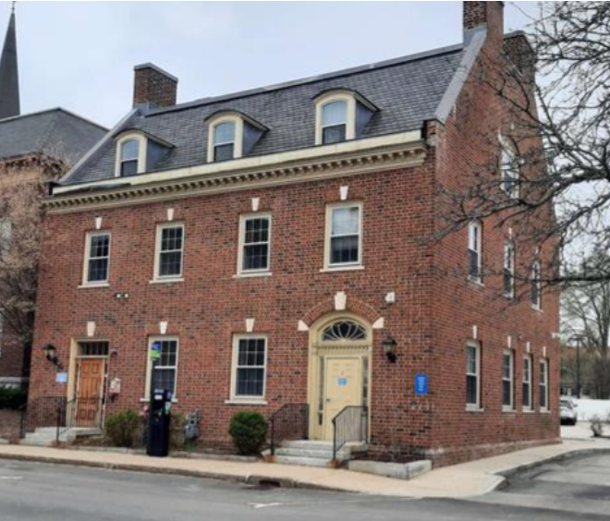
INDEPENDENT LIVING CONCORD
3 NORTH STATE STREET
GISG LLC
12 Units
Rental / Co-Op
Special Needs Housing
Rooming House
Projected Start Date: Spring 2025 (Subject to Funding)
City Support: $35,000 InvestNH Grant to Support Renovations

Slide 8
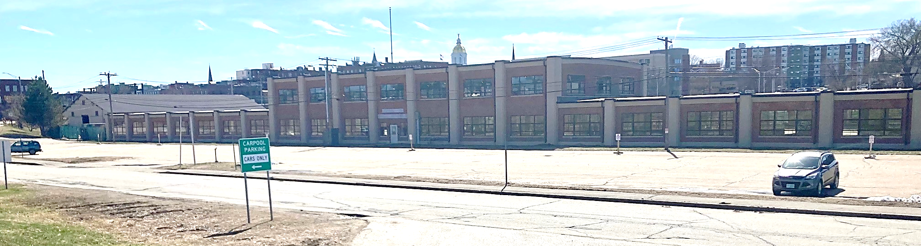
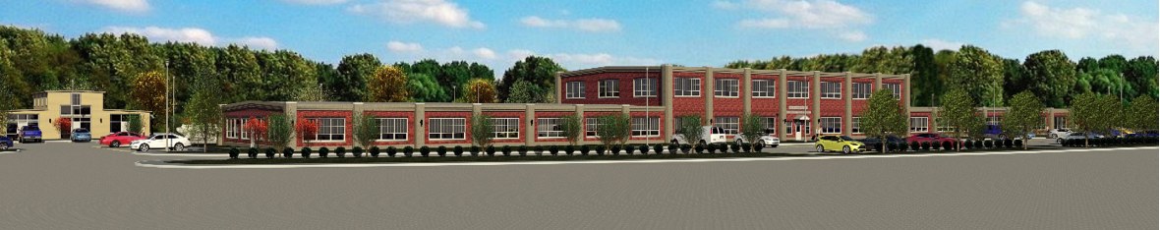
11 Stickney Avenue
11 Stickney Ave (80 Units)

Slide 9
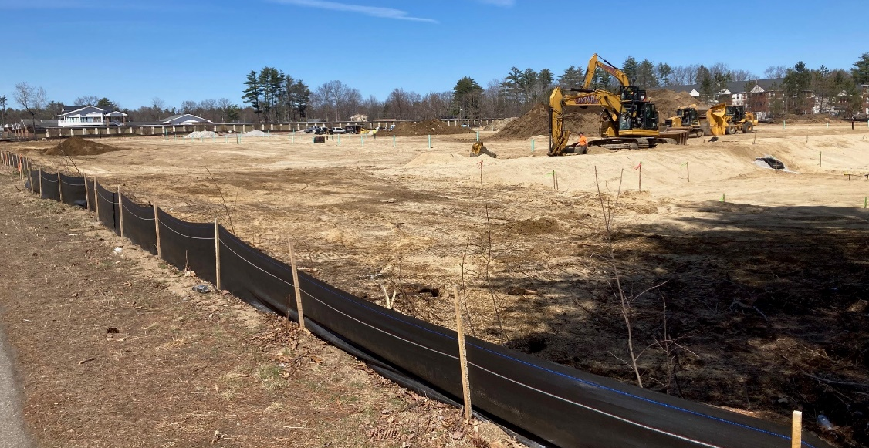
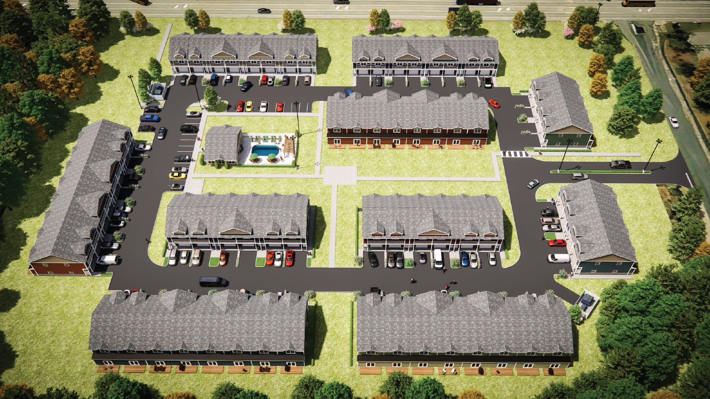
TANAGER CIRCLE TOWNHOMES
150 FISHERVILLE ROAD
North-South Construction
68 Units
For Purchase
Market Rate
Phased Project
Estimated Completion 2025-2027+/-

Slide 10
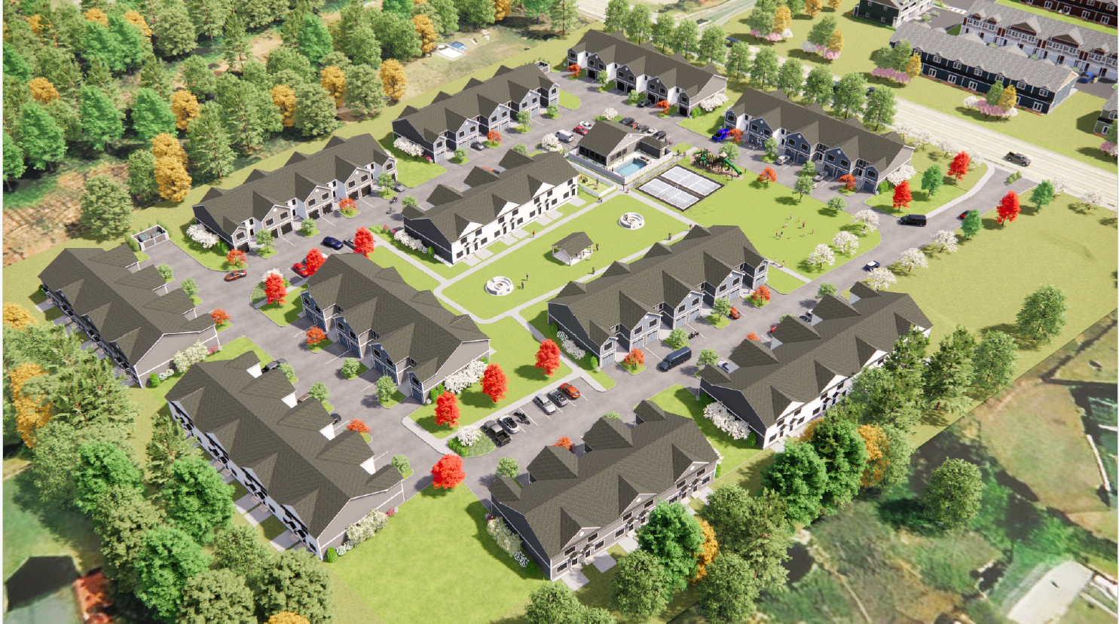
FISHERVILLE RD TOWNHOMES
153-169 FISHERVILLE ROAD
NH Sustainable Communities LLC
83 Units
For Purchase
Market Rate
Phased Project
Estimated Completion 2027-2028

Slide 11
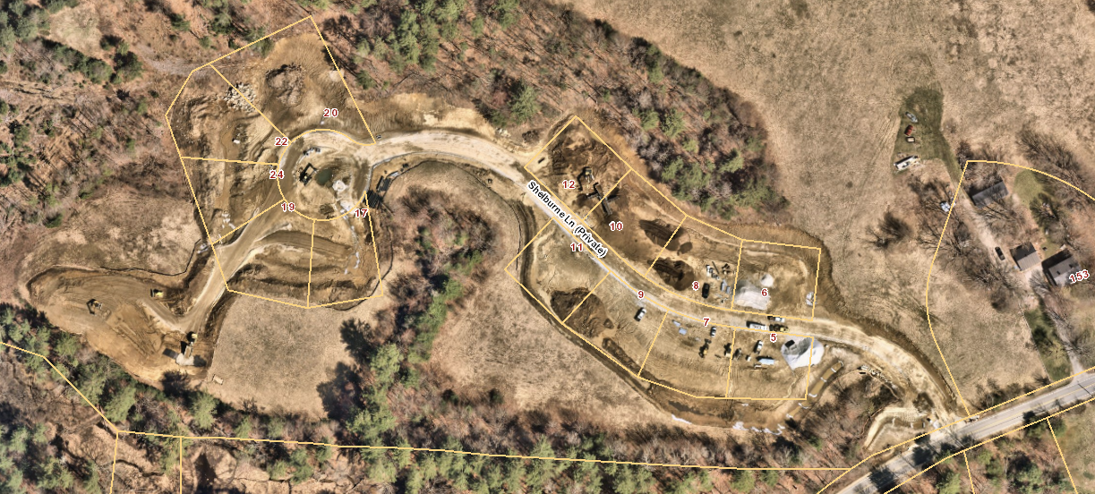
SHELBURNE LANE
13 Lot Single Family Detached Home Subdivision
Market Rate; For Purchase
Projected Completion 2025-2026

Slide 12
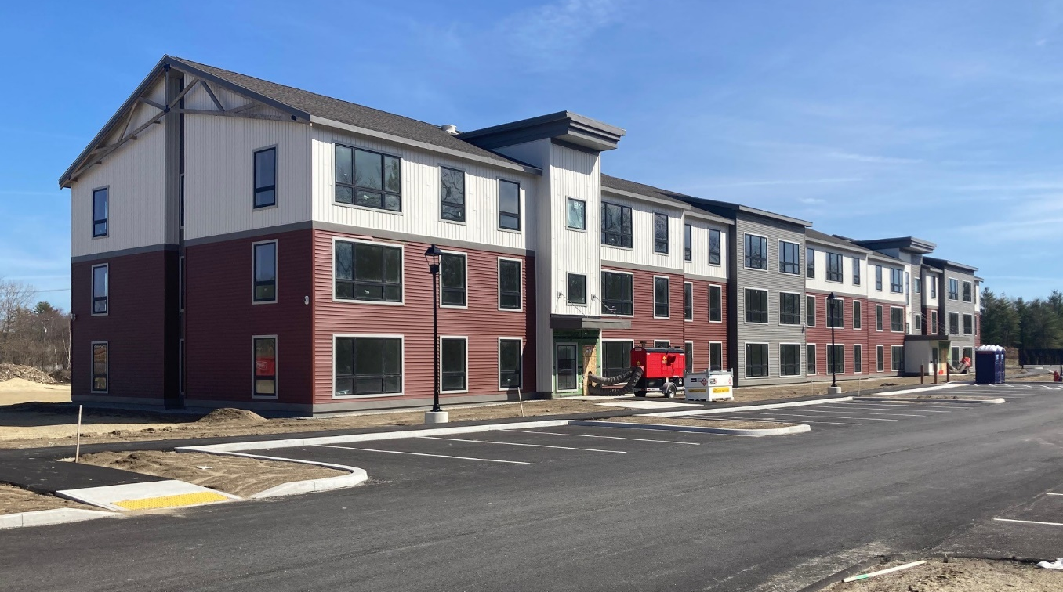
RAIL YARD APARTMENTS PHASE 2
LANGDON AVENUE
Dakota Partners
Phase 2 = 96 Units (192 Units Total)
Rental
Affordable
Schedule Pending

Slide 13
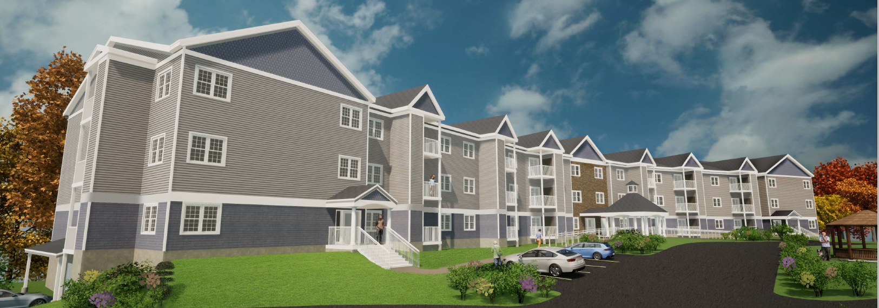
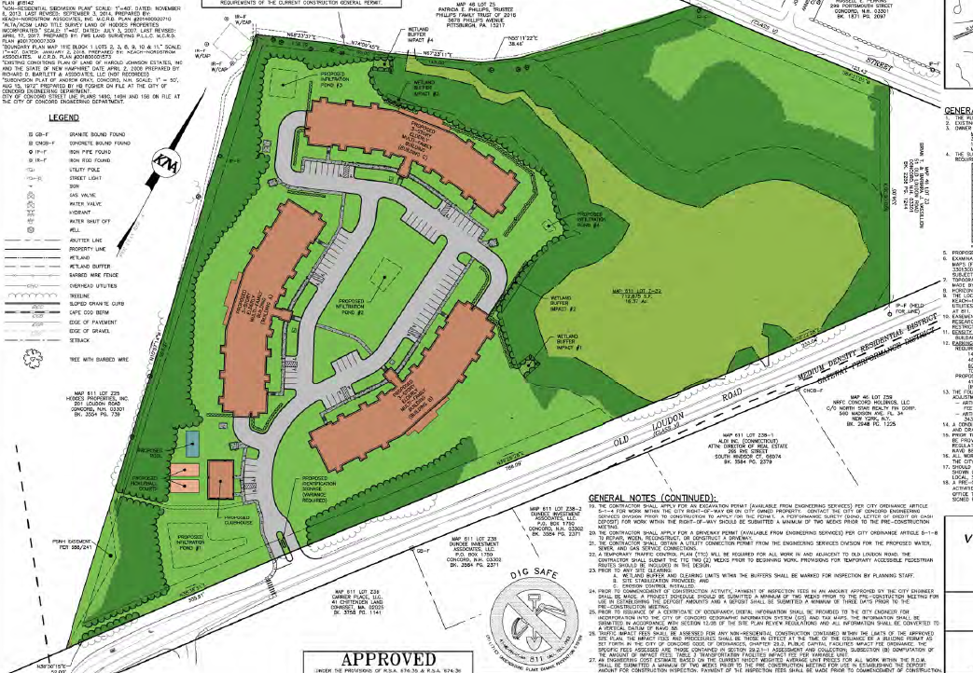
VILLAGE AT CAPITAL CROSSING
33 OLD LOUDON ROAD
33 Old Loudon Rd LLC
144 Units
Rental (Senior)
Market Rate
Starting February 2025
Estimated Completion Late 2026 / Early 2027
City Support
  Heights Sewer Project

Slide 14
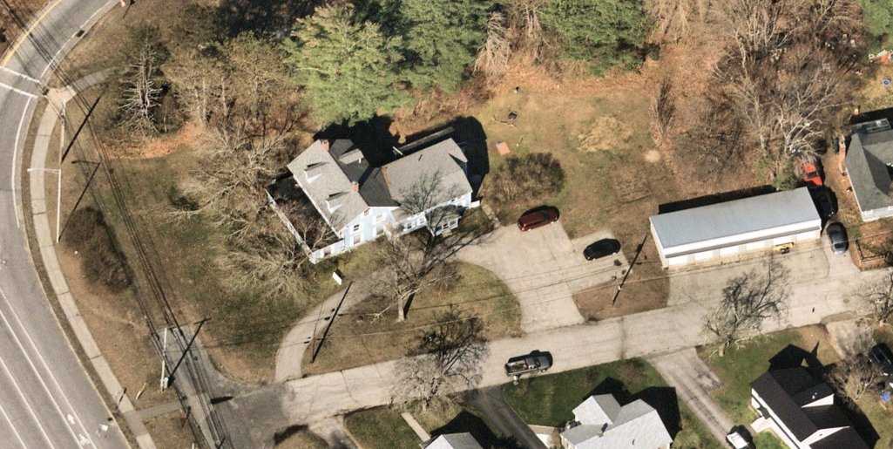
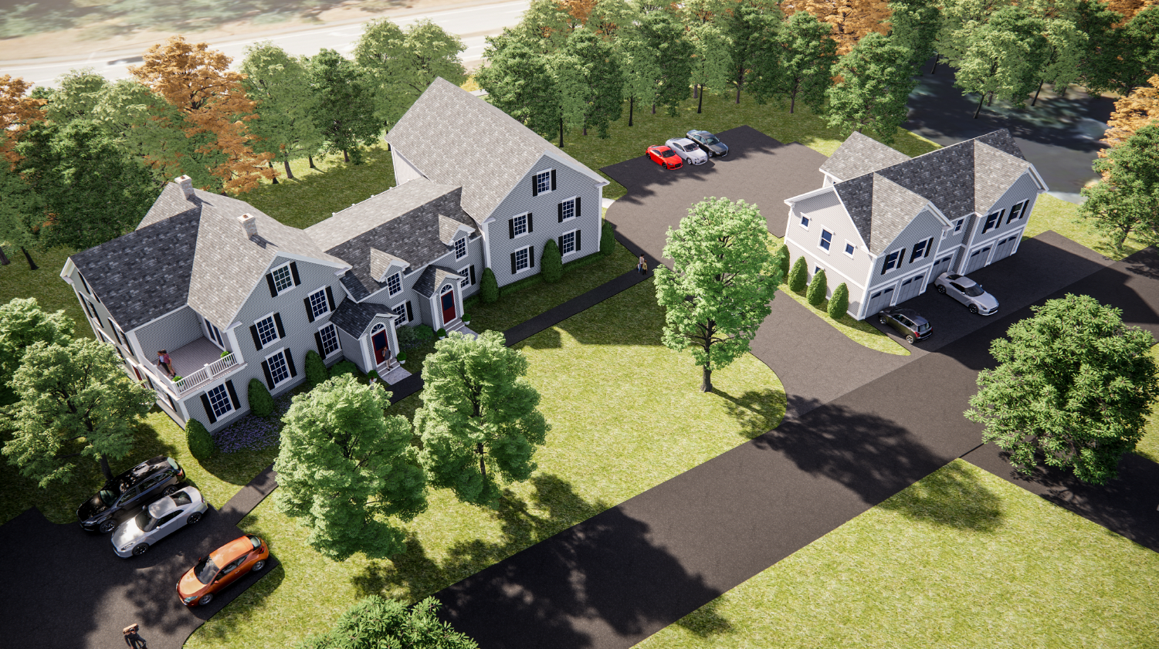
ZV PROPERTIES
5 THOMAS STREET
ZV Properties LLC
9 Units (6 Net New)
Rental
Market Rate
Projected Start Date: 2025
City Support:
  License to use City Property for Driveway to Parking Lot & Dumpster

Slide 15
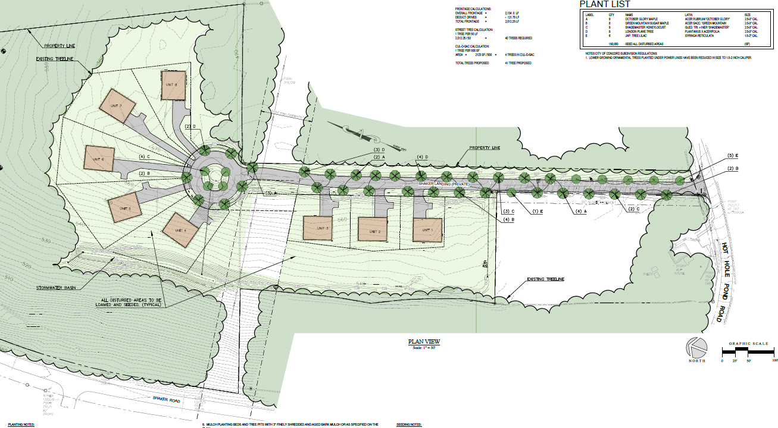
SUNNIVA RIDGE LANE
(HOT HOLE POND ROAD)
R&C Eastern Development LLC
8 Units
For Purchase
Market Rate
Projected Start Date: 2025

Slide 16
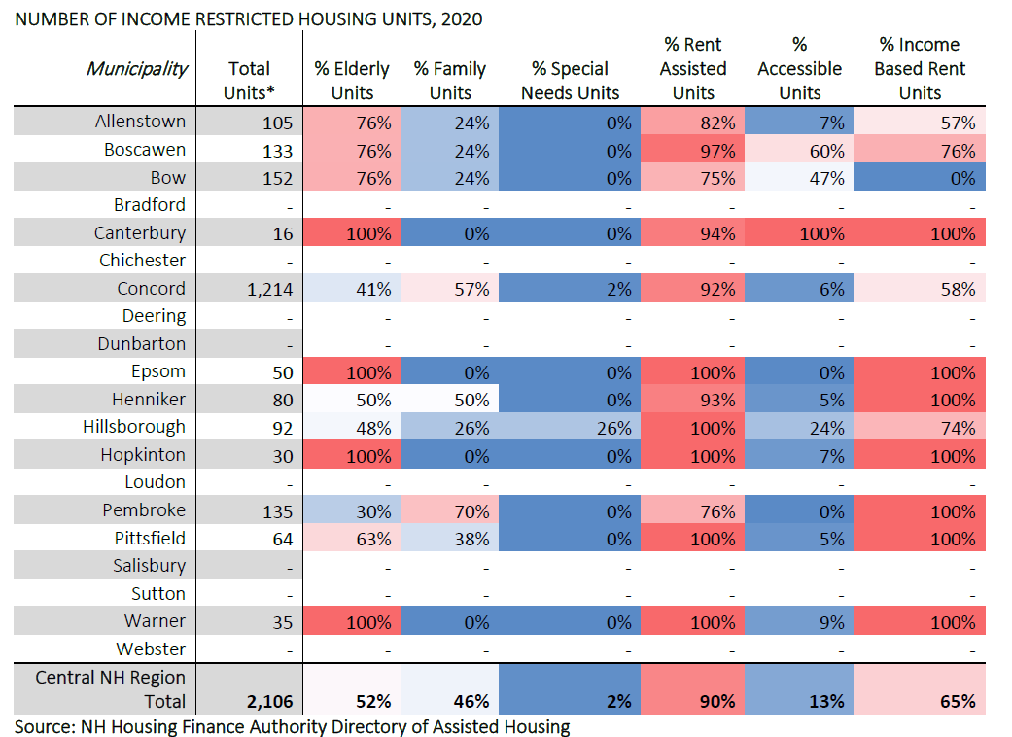
INCOME RESTRICTED UNITS (2020)

Slide 17
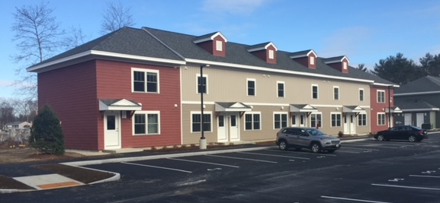

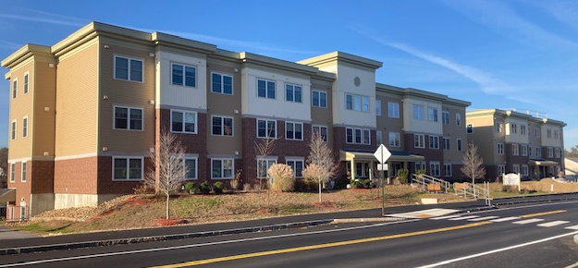
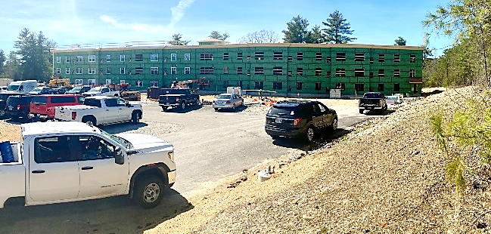
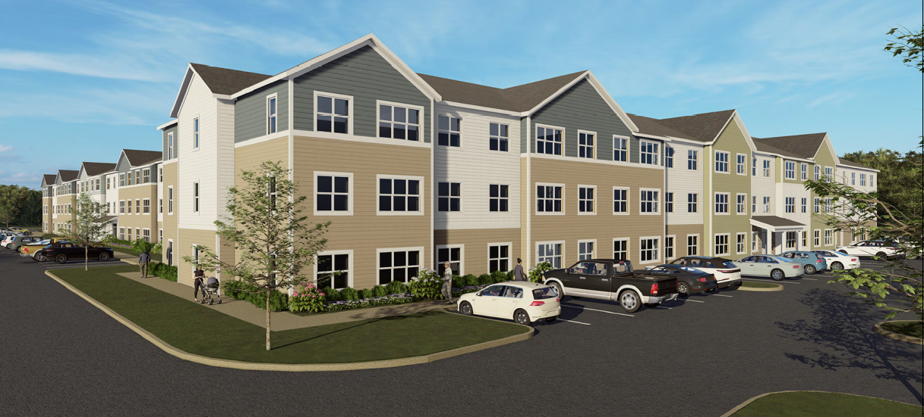
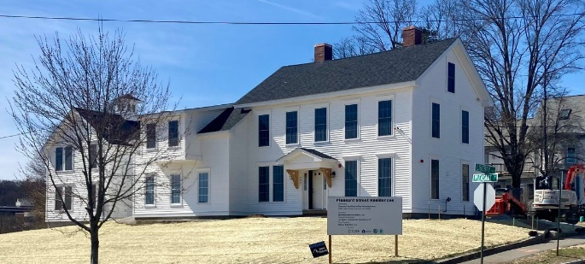
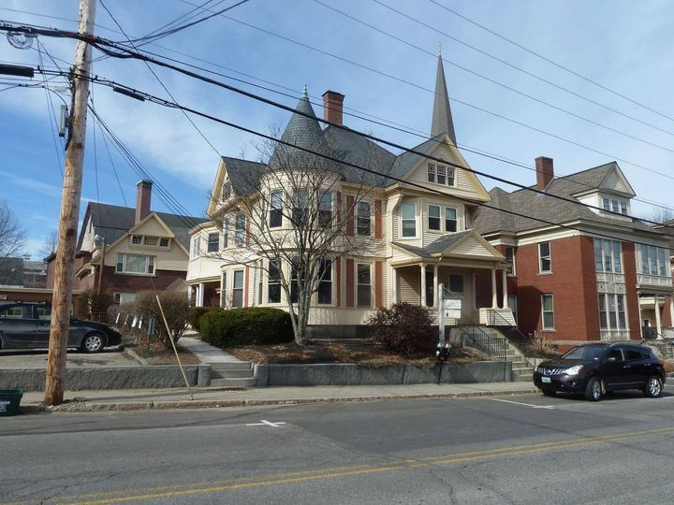
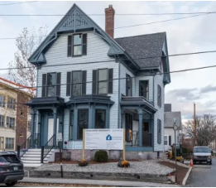
2020-2026
505 AFFORDABLE HOUSING UNITS
Rosemary’s Way (42 Units)
Rail Yard (192 Units)
Penacook Landing (54 Units)
Davis Ridge (48 Units)
Brookline Opportunities (123 Units)
Pleasant St Residences (6 Units)
6 South State St (8 Units)
Green St Residences (4 Units)

Slide 18
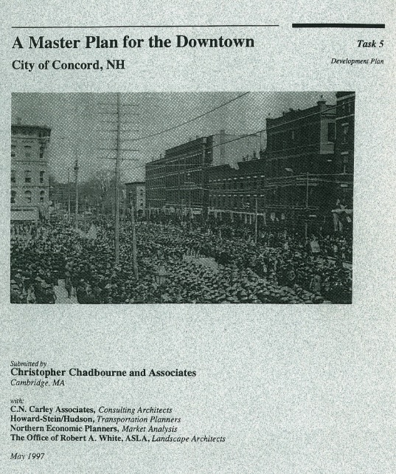
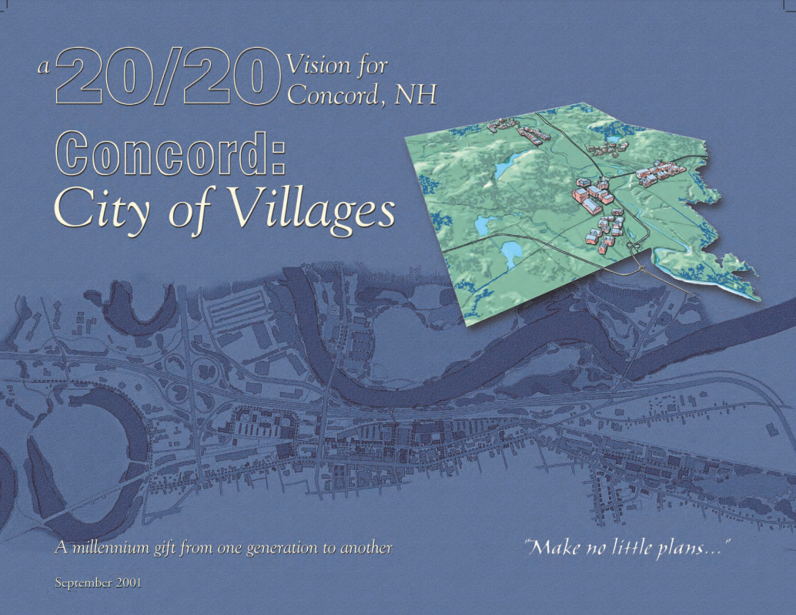
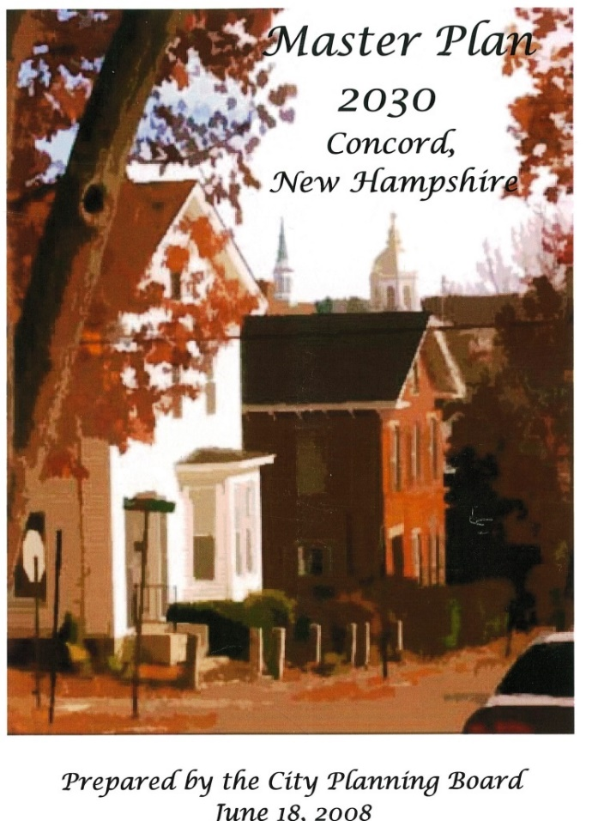
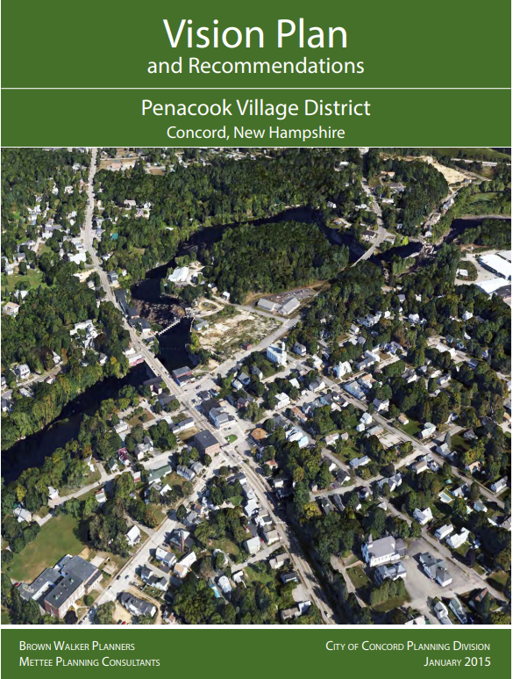
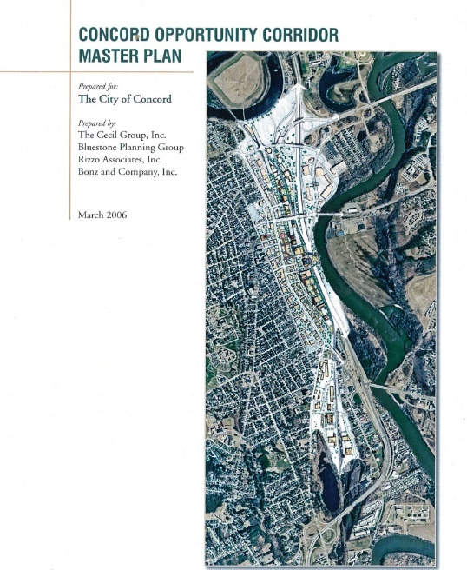
City Master Plan Update

Slide 19
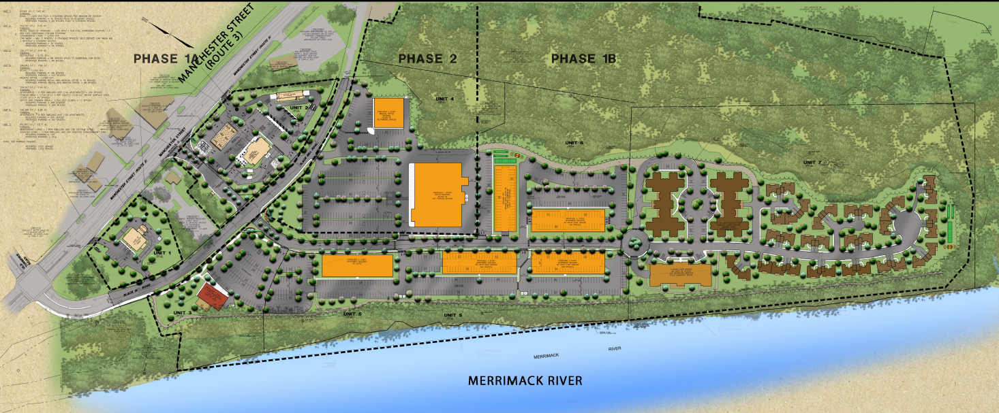
ROI PROPERTIES
BLACK HILL ROAD
ROI Properties LLC
385 Units
  266 Apartments
  119 Assisted Living
Rental / Market Rate
City Support:
  2019 Zoning Amendments
    Rezoned Residential Open Space to Gateway Performance
    Permitted Residential Uses in the Gateway Performance District

Slide 20
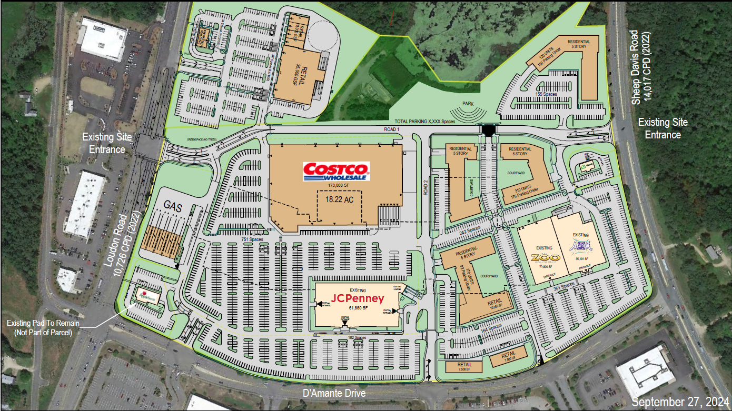
FORMER STEEPLEGATE MALL / REGAL CINEMA
270 LOUDON ROAD
Onyx Partners Ltd.
600 Units
Rental / Market Rate
City Support:
  Heights Sewer Project ($25M)
  Request for Public-Private Partnership for additional infrastructure improvements under consideration

Slide 21
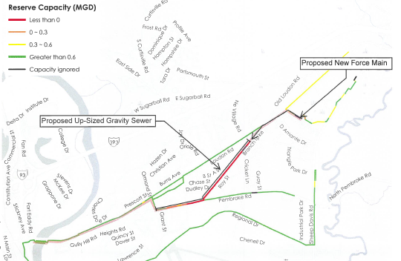
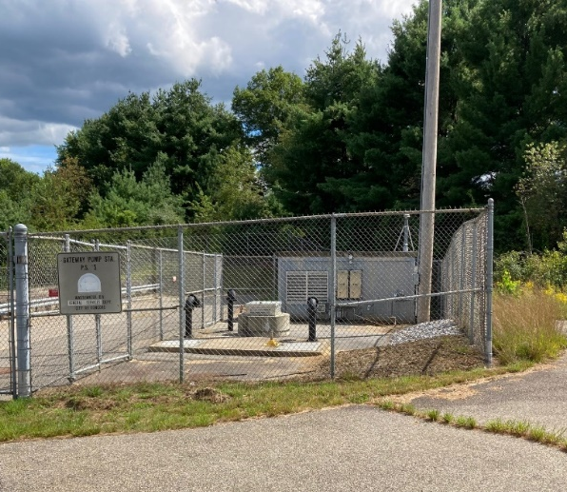
HEIGHTS SEWER IMPROVEMENTS
Heights Sewer Project: Fall 2025 Start; Early 2027 Completion
$25 Million Investment (Funded by Rate Payers)

Slide 22
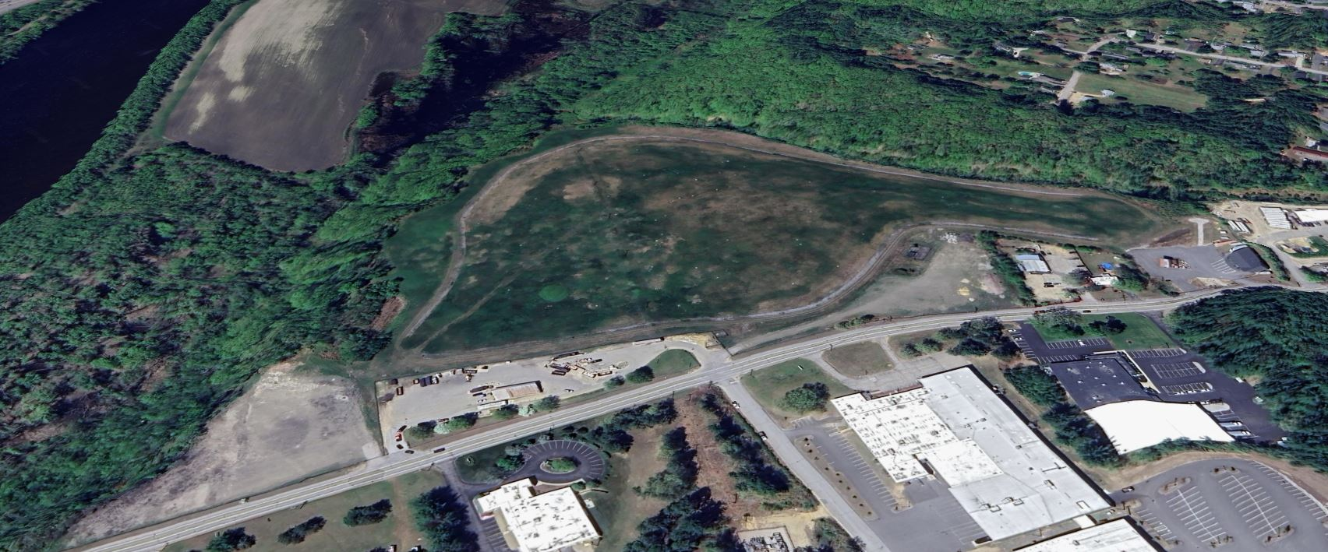
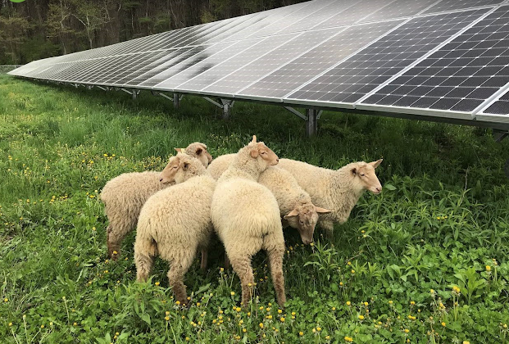
SUSTAINABILITY

Slide 23
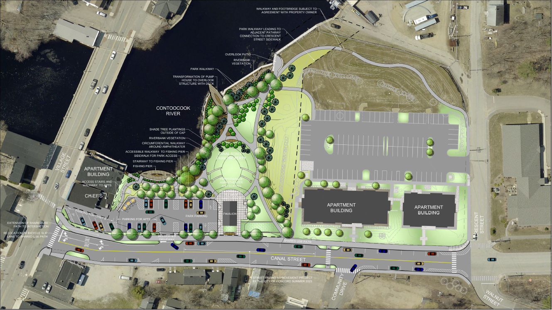
PENCOOK LANDING PHASE 2
CANAL STREET RIVERFRONT PARK

Slide 24
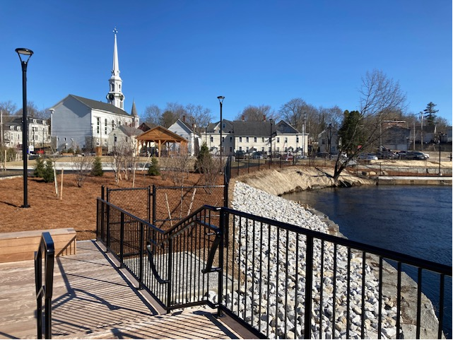
PENCOOK LANDING PHASE 2
CANAL STREET RIVERFRONT PARK

Slide 25
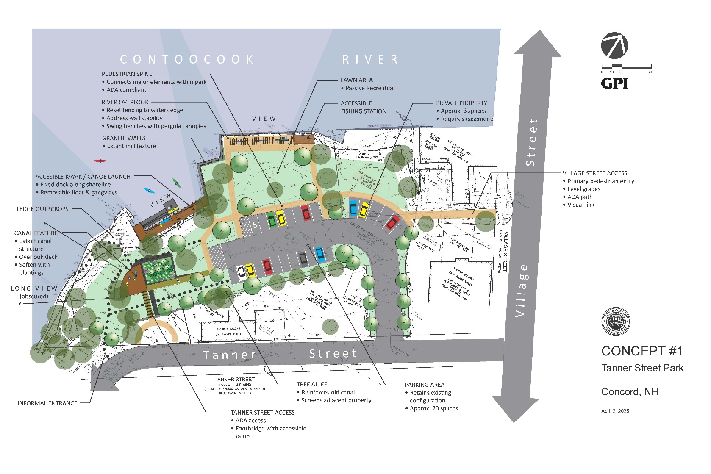
PENCOOK RIVERSIDE PARK
CONCEPT #1

Slide 26
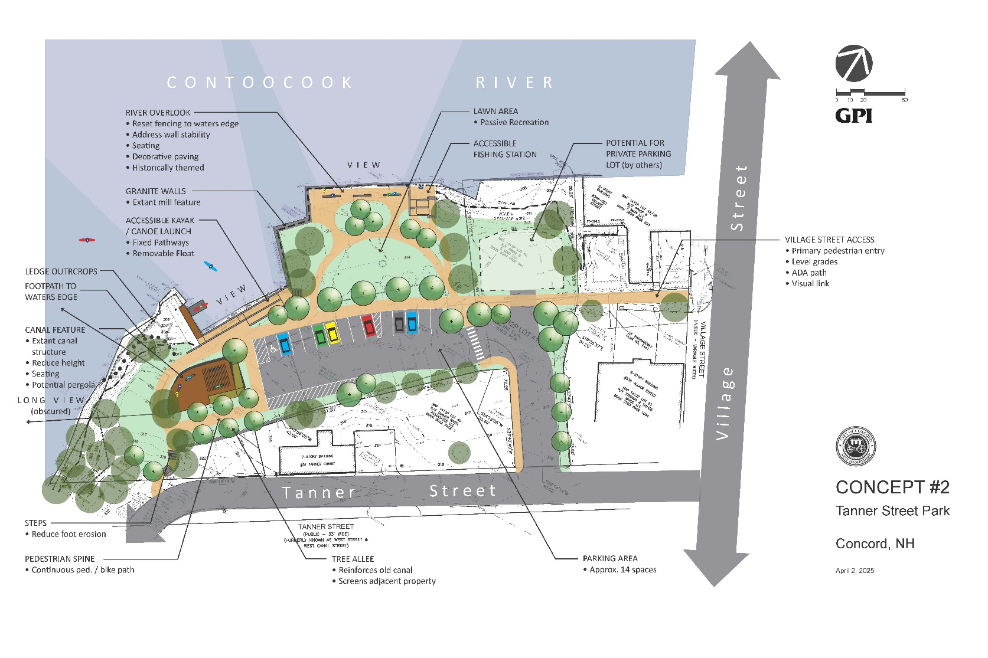
PENCOOK RIVERSIDE PARK
CONCEPT #2

Slide 27
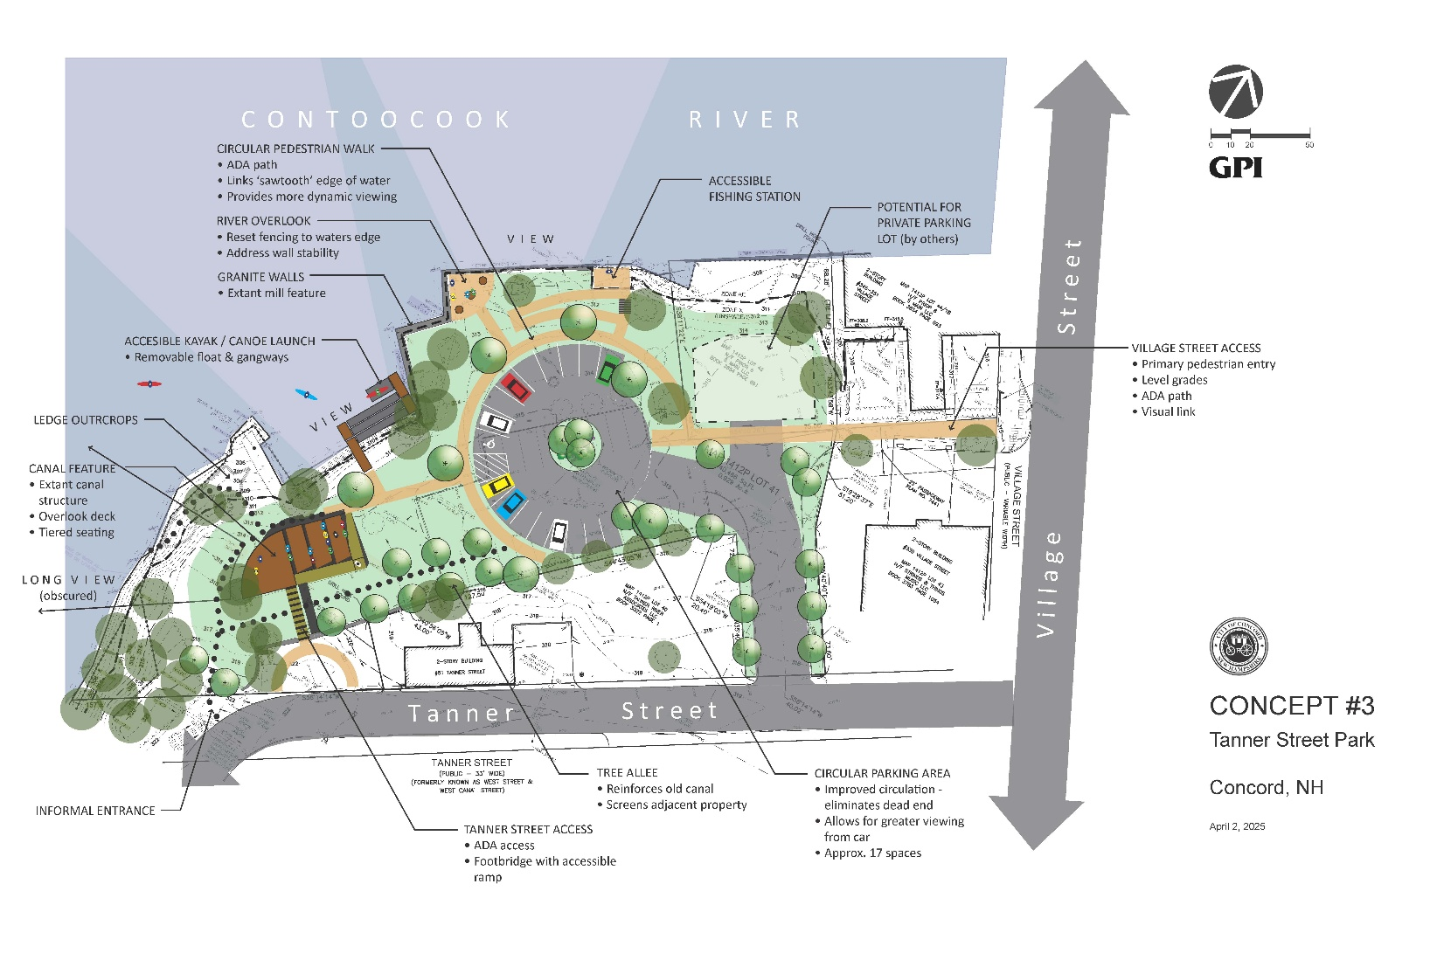
PENCOOK RIVERSIDE PARK
CONCEPT #3

Slide 28
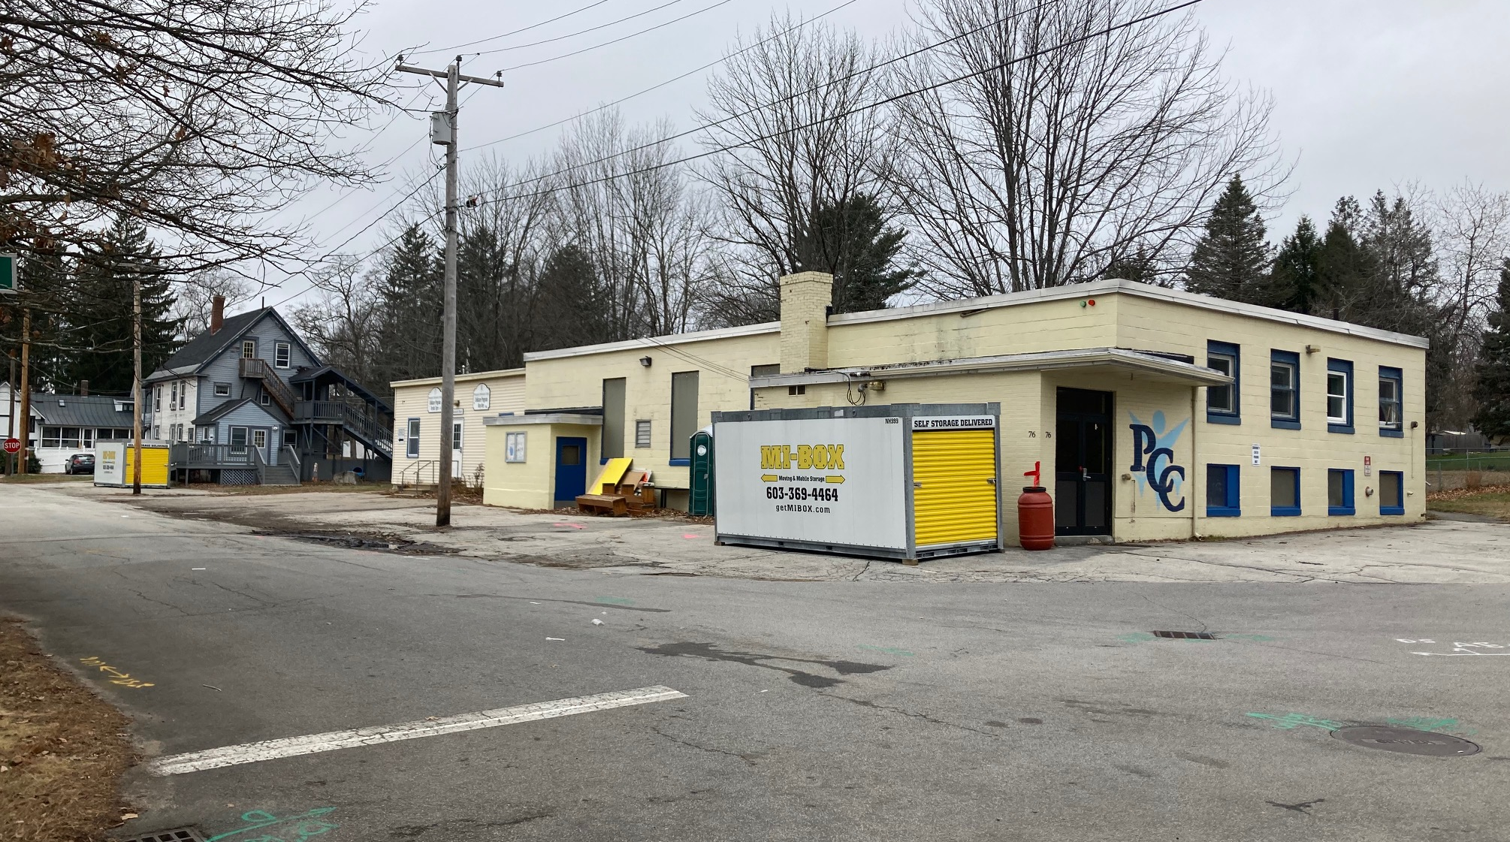
B&GC / Penacook Branch Library & ACTIVITY Center

Slide 29
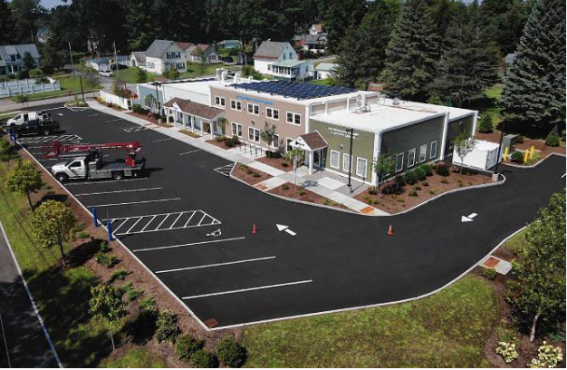
B&GC / Penacook Branch Library & ACTIVITy Center

Slide 30
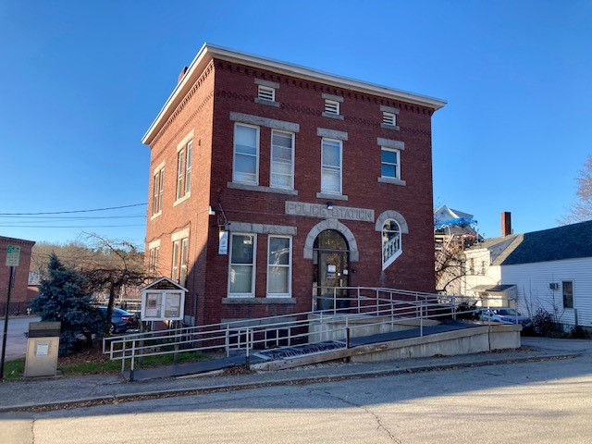
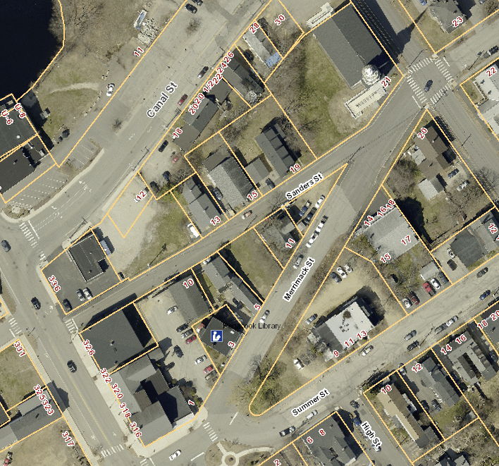
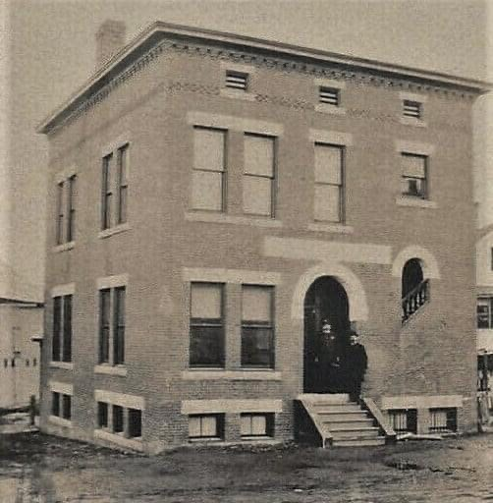
B&GC / Penacook Branch Library & ACTIVITY Center

Slide 31
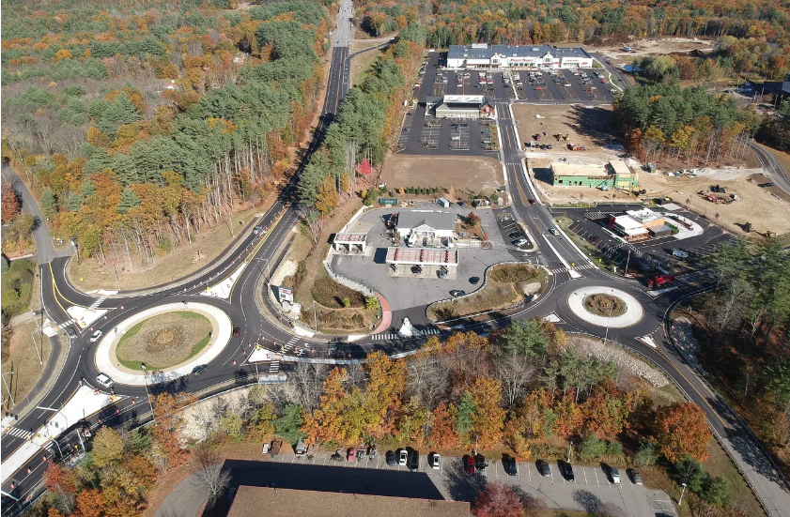
Exit 17 / Whitney Road
Photo Credit: Interchange Development LLC

Slide 32
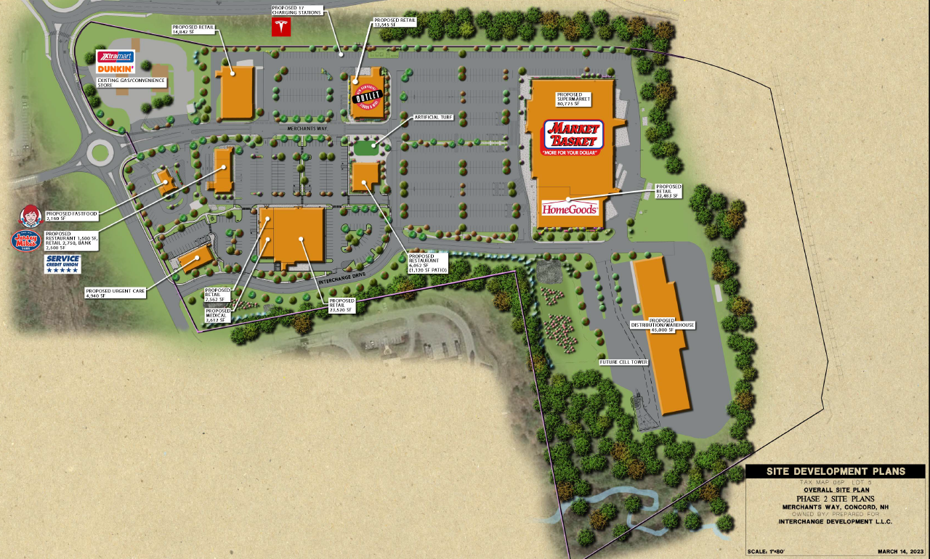
Exit 17 / Whitney Road
Photo Credit: Interchange Development LLC

Slide 33
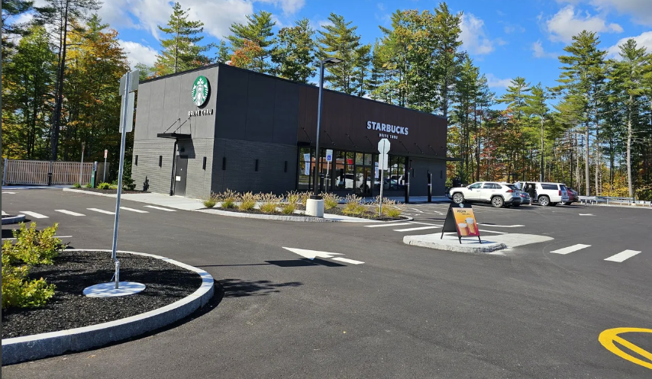
Exit 17 / Whitney Road
Photo Credit: Interchange Development LLC

Slide 34

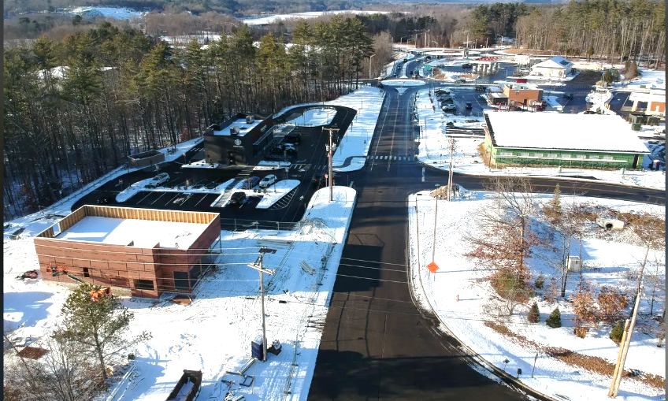

Exit 17 / Whitney Road
Photo Credit: Interchange Development LLC

Slide 35
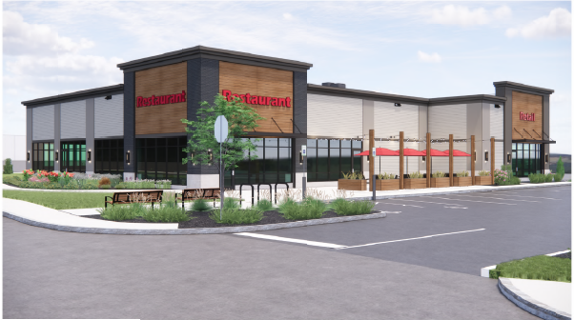
Exit 17 / Whitney Road
Photo Credit: Interchange Development LLC

Slide 36




20 SOUTH MAIN STREET
Photo Credit: The Duprey Companies / ProCon

Slide 37

Legislative Parking Garage
33 Capitol Street

Slide 38

Legislative Parking Garage
Storrs Street

Slide 39

Nh State Hospital Expansion
Photo Credit: PC Construction

Slide 40


New police station

Slide 41

New police station
52,137SF (3,315SF Future Growth)
1-3 Stories + Partial Basement
91 +/- Parking Spaces
$38,067,902 (Q2 2025; Excludes Land & Environmental Abatement)

Slide 42
$5,351,603

Slide 43
Questions?

