Slide 1

City of Concord
FISCAL YEAR 2023
Budget Presentation

Slide 2
As stewards of taxpayer dollars, I hope you will find this presentation helpful. It is intended to provide an overview of the City's proposed budget.
This budget marks a proactive “restart” to more robustly implement the City Council’s vision to improve the quality of service delivery for our residents and business owners. It addresses needed investments to ensure economic vitality in the future.

Slide 3
FISCAL MANAGEMENT
AA+ S&P Bond Rating
Certificate of Achievement for Excellence in Financial Reporting - 26th Year
Distinguished Budget Presentation Award - 7th Year

Slide 4
TOTAL BUDGET OVERVIEW
The proposed FY23 budget includes a 4.8% tax rate increase.
FY22 Adopted Budget*: $109.3 million
FY23 Proposed Budget*: $123.6 million
*Includes CIP (Capital Improvement Projects)

Slide 5
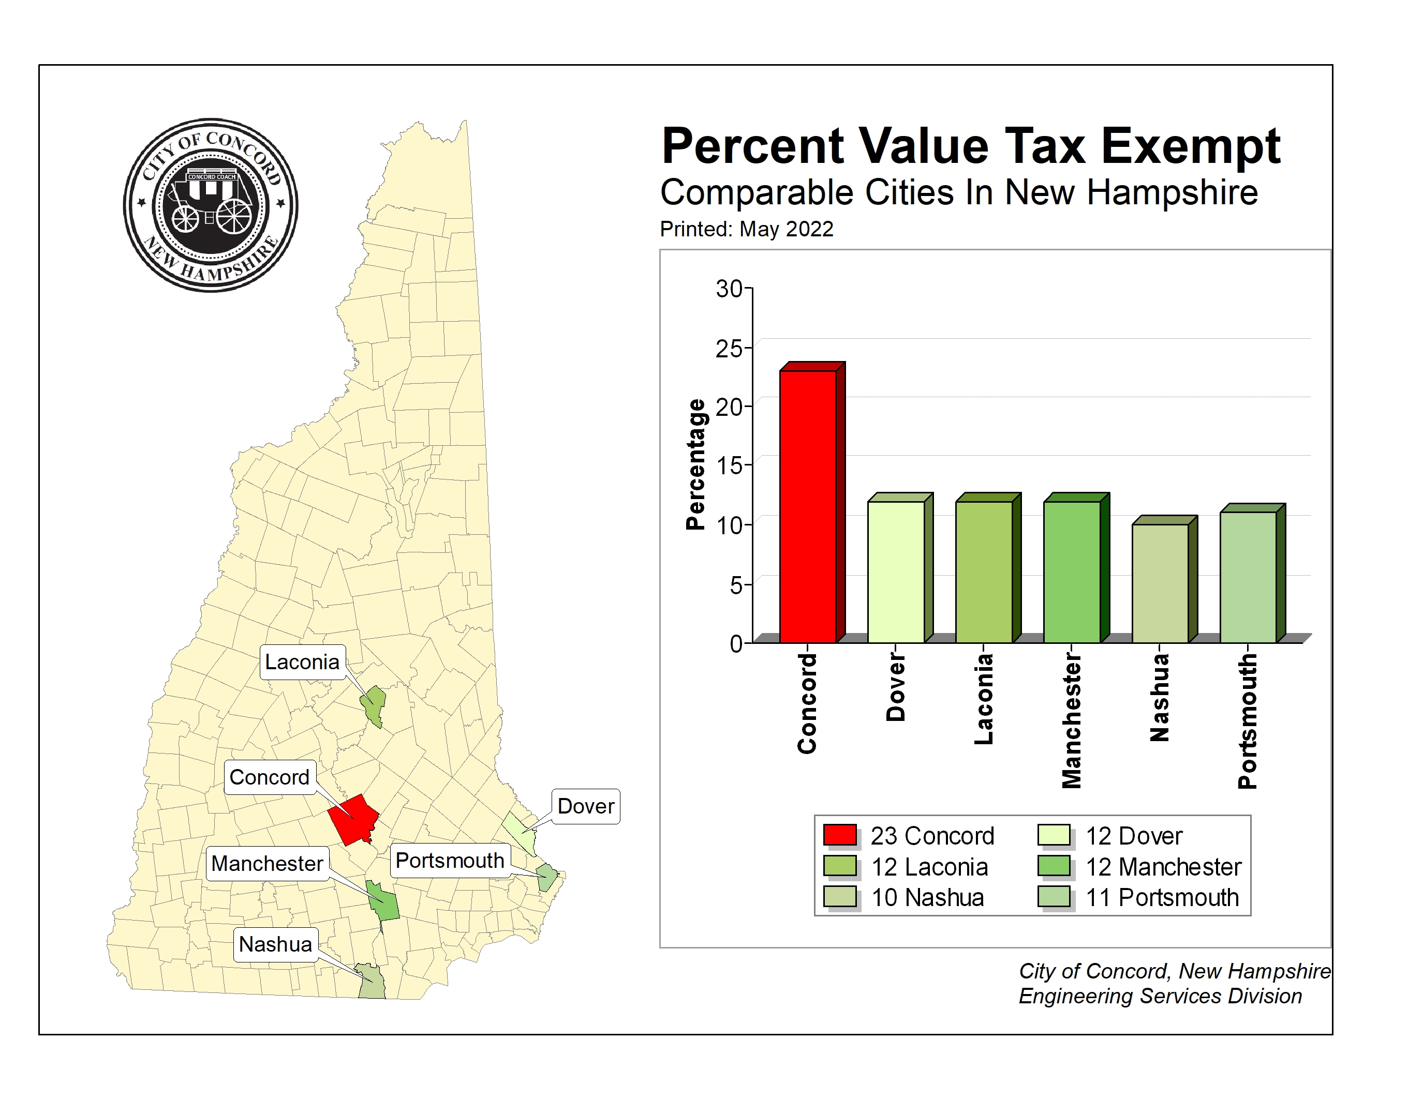

Slide 6
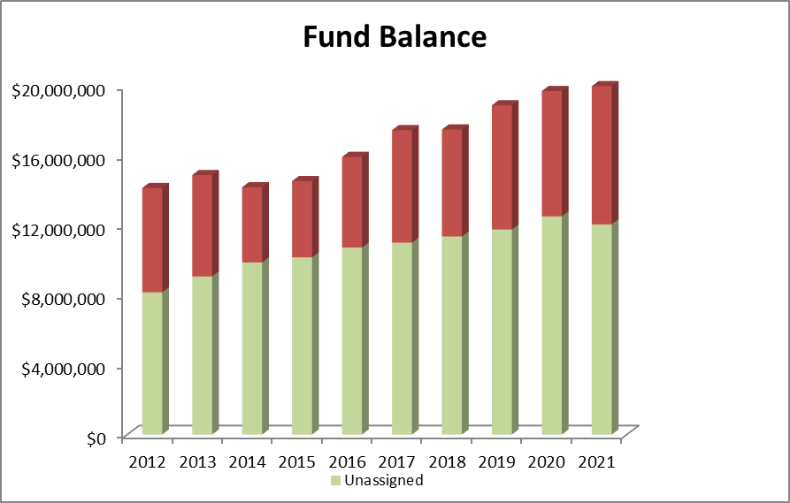

Slide 7
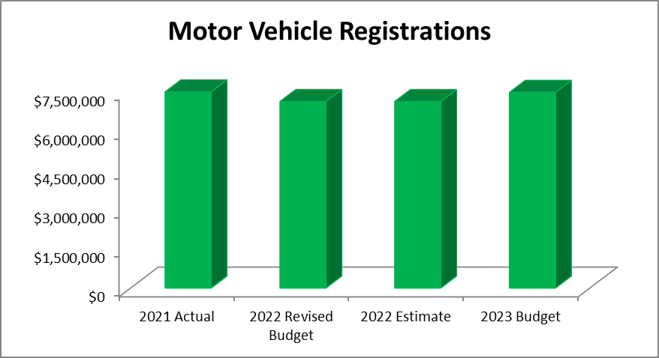

Slide 8
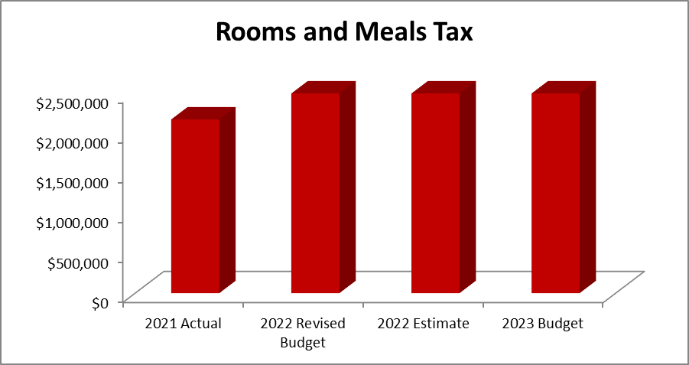

Slide 9
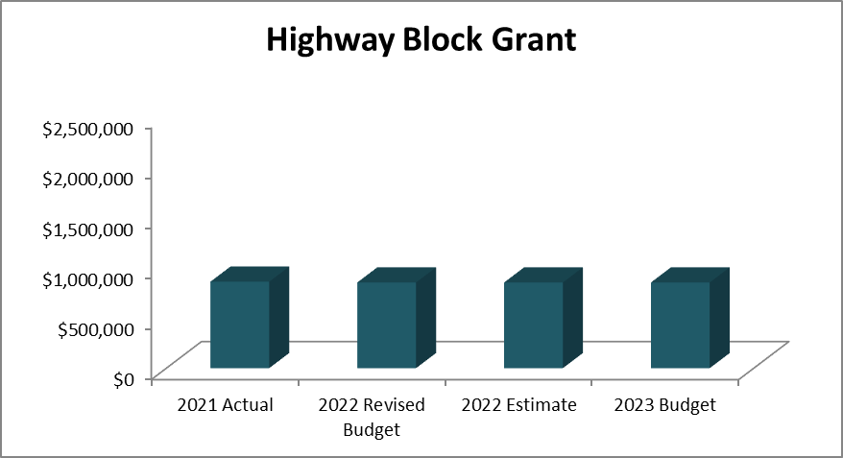

Slide 10
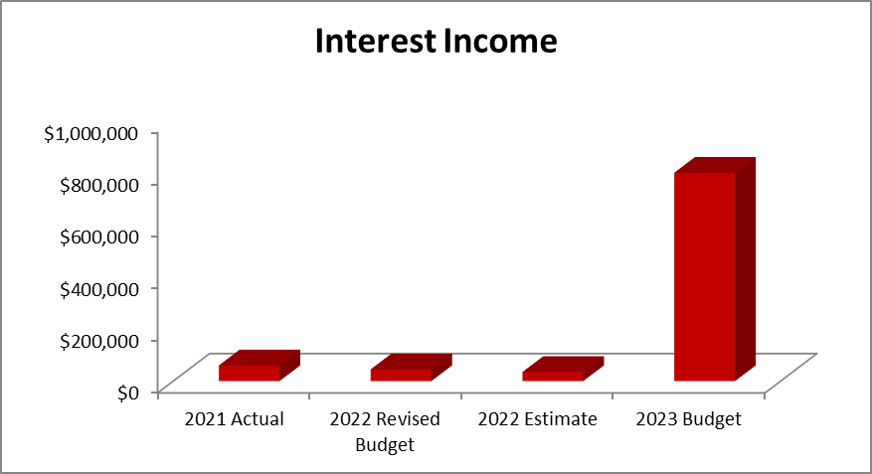

Slide 11
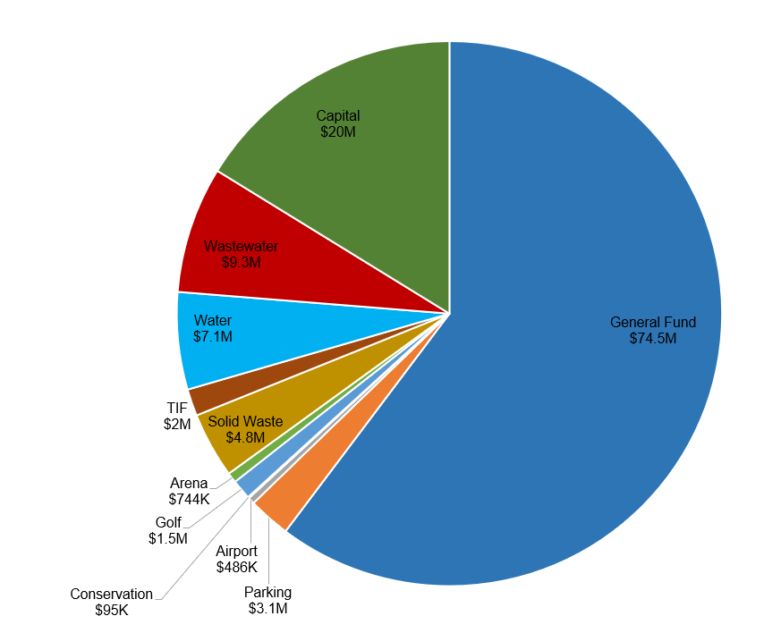
TOTAL BUDGET OVERVIEW

Slide 12
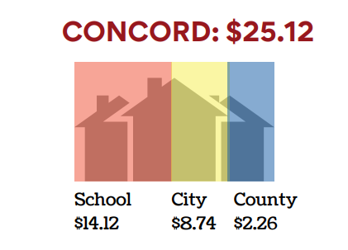
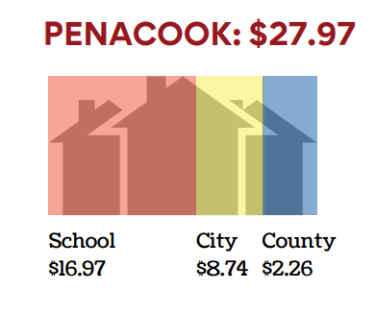
PROPERTY TAX RATES

Slide 13
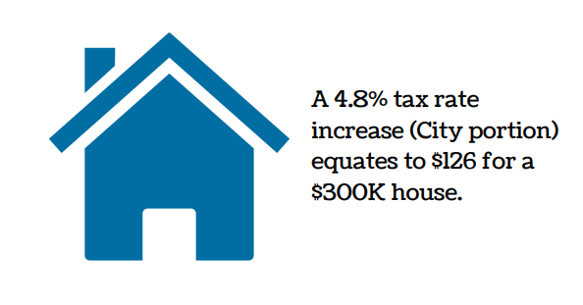
TAX RATE IMPACT

Slide 14
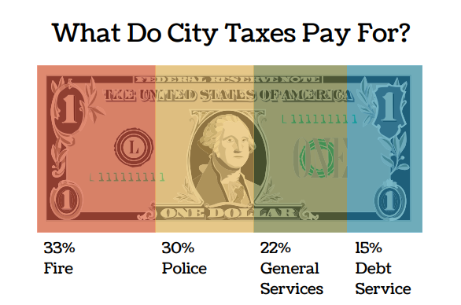

Slide 15
GENERAL FUND OVERVIEW
General Fund Expenses by Function

Slide 16
GENERAL FUND OVERVIEW
General Fund Expenses by Classification

Slide 17
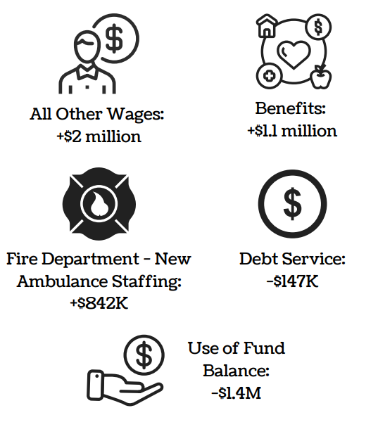
BUDGET TO BUDGET GENERAL FUND COMPARISON – FY22 to FY23
Notable Budget Increases / Decreases:

Slide 18
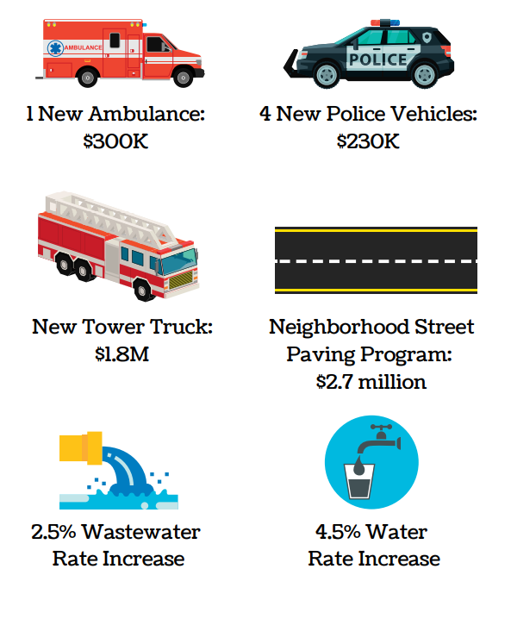
NOTABLE ITEMS IN THE
FY23 BUDGET

Slide 19
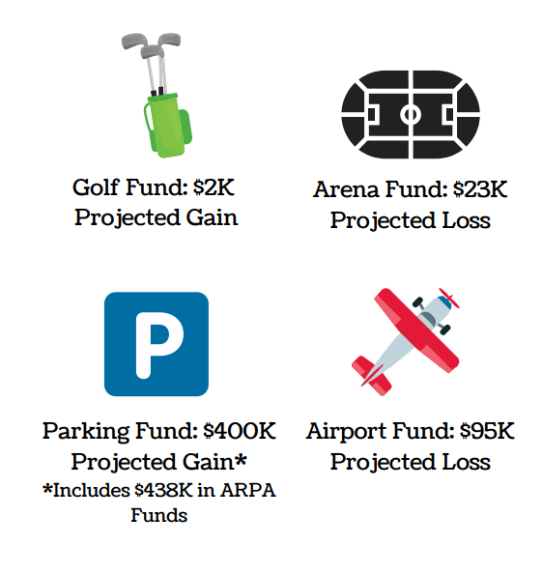
NOTABLE ITEMS IN THE
FY23 BUDGET

Slide 20
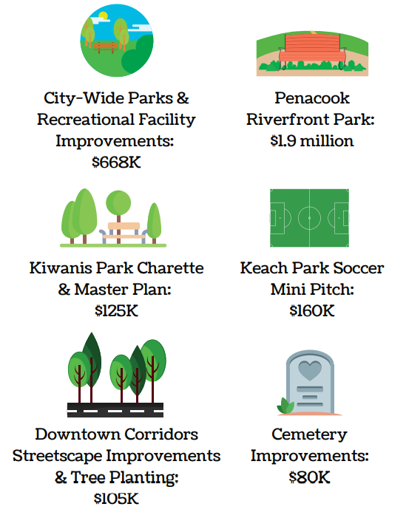
CAPITAL IMPROVEMENT PROJECTS

Slide 21
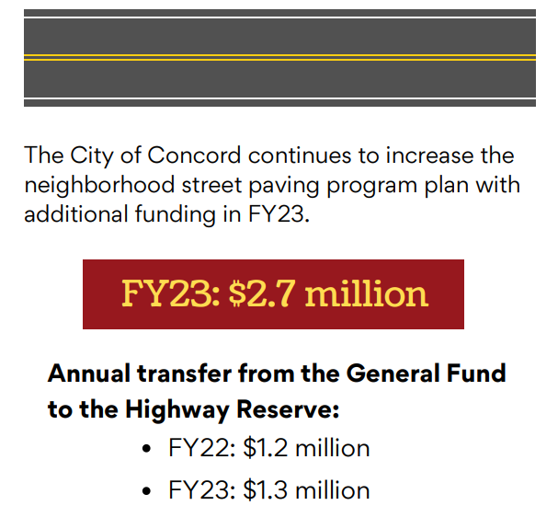
NEIGHBORHOOD STREET
PAVING PROGRAM

Slide 22
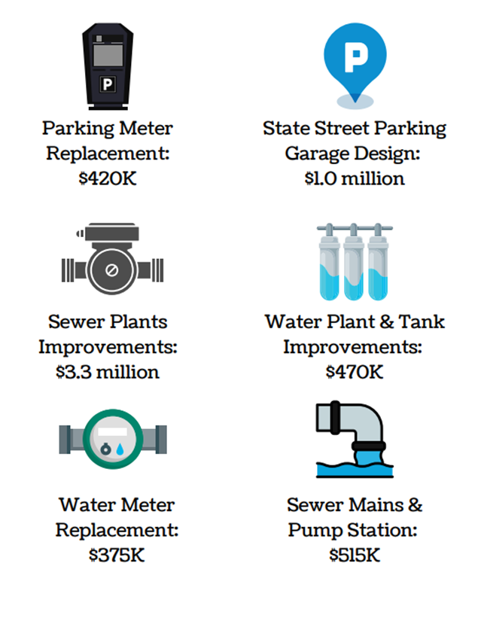
CAPITAL IMPROVEMENT PROJECTS

Slide 23
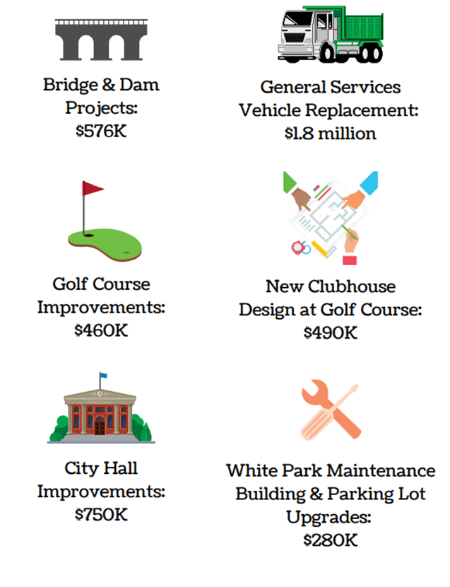
CAPITAL IMPROVEMENT PROJECTS

Slide 24
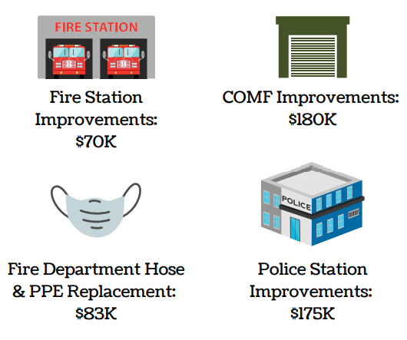
CAPITAL IMPROVEMENT PROJECTS

Slide 25
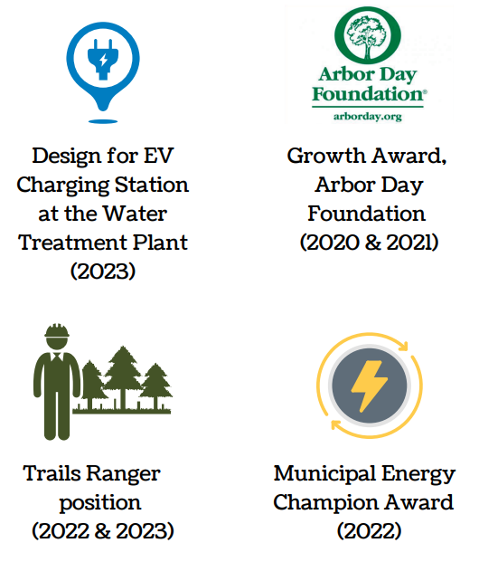
SUSTAINABILITY INITIATIVES
FISCAL YEAR 2023

Slide 26
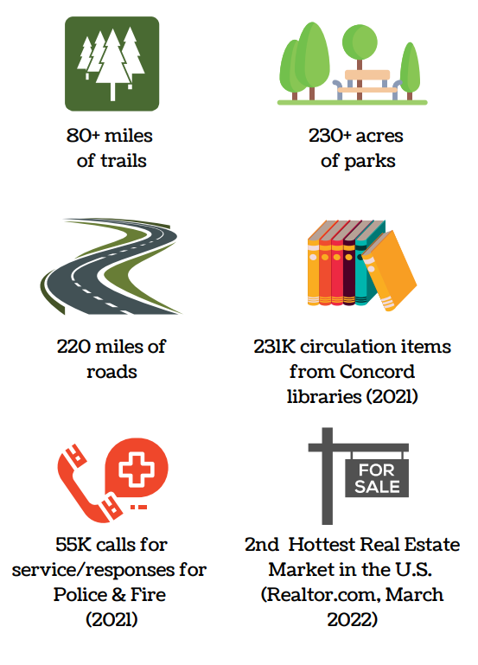
CONCORD AT A GLANCE

Slide 27
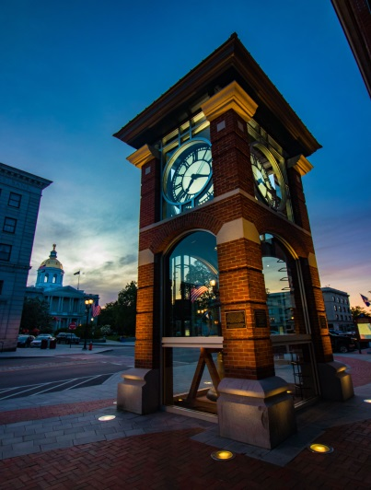
Thank You For Listening

